Slide 1


Slide 2

Remote Execution for Oracle SQL
https://method5.github.io

Slide 3
Summary
Relational remote execution SQL extension
Easily run SQL, PL/SQL, and shell scripts
Advanced features in a simple syntax: select * from table(m5('select * from dual'));
Powerful add-ons
Open-source, secure, agentless, robust implementation
Remote execution is not just faster
More resources - https://method5.github.io

Slide 4


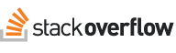


About Jon Heller
Oracle developer or DBA for 17 years
DBA at Ventech Solutions in Urbandale, Iowa
Stack Overflow top user in Oracle and PL/SQL
github.com/jonheller1
BS and MCS in Computer Science, NCSU
Certifications: PL/SQL, DBA, SQL Expert, SQL Tuning
jon@jonheller.org

Slide 5





Oracle Automation Gap
Groundhog Day DBA
row-by-row, DB-by-DB
Only obvious tasks are automated
Tools are often slow, complex, insecure, expensive
Tools are not relational
Notes:
(Not all of these criticisms apply to all of the listed tools.)
1. DBAs spend too much time fixing the same problems again and again on different databases. When you find a rare problem you won't always spend the time to check other databases, it's not worth it. You can't perform simple tasks or answer simple questions across all your databases. SQL, PL/SQL, and the relational model help solve many of these problems, but they are stuck inside a single database. Why can't you treat all of your databases as a single entity?
2. Oracle developers know to avoid row-by-row processing; it's slower and more complicated than set-based processing. Likewise, we should avoid database-by-database administration.
3. You have tools to automate common, predefined tasks like cloning, installing, patching, and deployments. But why not bring automation to tuning, troubleshooting, and other ad hoc tasks?
4. Existing tools and processes are not good enough to transform the way you work. They're often too slow (too much overhead or don't run in parallel), complex (require new technologies, hardware, privileges, IDEs, plugins, websites, agents, and processes), insecure (many programs promote shared or hard-coded passwords), or expensive (even the open source programs are often not completely open source, and may require huge amounts of money for add-ons and consulting). Programs like Ansible, Salt, and Fabric can radically alter the way system administrators work. But they probably won't do the same for Oracle databases.
5. Most importantly, none of the alternatives are relational. There's nothing wrong with Java, SSH, Python, shell scripts, text files, XML, JSON, etc. But those are not the native language of databases.

Slide 6
Ideal Solution
Treat everything as one database
New dynamic SQL - control what and where
New SQL syntax would be perfect: SELECT * FROM DBA_USERS WHERE PROFILE = 'DEFAULT' TARGETS ('DEV', 'QA')
We can get surprisingly close to that
Notes:
1. We want to access anything in one statement. We want to pretend a thousand databases are just one.
2. Dynamic SQL is sometimes classified as Method 1, 2, 3, or 4. Method 1 is static, and Method 4 is so dynamic that even the select list is a variable. You need a new type of dynamic SQL, a Method 5, where even the location is a variable. This allows you to programmatically control both what to run and where to run it. It should run anywhere SQL can run and should not require anything other than an Oracle database.
3. A new syntax would be nice - something like the 12c `CONTAINERS` clause on steroids.
4. We can't change SQL syntax but with Oracle Data Cartridge we can get very close.

Slide 7
Interface - Function or Procedure
select *
from table(m5('select * from dual', 'dev,qa'));
begin
m5_proc(
p_code => 'begin null; end;',
p_targets => 'dev,qa',
p_table_name => 'test_data',
p_table_exists_action => 'drop',
p_asynchronous => true,
p_run_as_sys => false
);
end;
/
WHAT
WHERE
WHAT
WHERE
HOW
Notes:
Method5 can be run as either a function or a procedure. They let you specify what to run, where to run, and how to run. The function returns results immediately. The procedure saves the results in background tables, and it gives you more control over how the commands are run.
Running as a function is simple and neat, but in practice advanced users will normally want to run things as a procedure. Running as a procedure makes it asynchronous, which is good for large jobs you don't want to wait for. It also makes it possible to schedule and chain tasks.

Slide 8
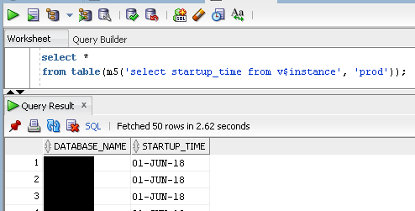
Simple Example - Function
Notes:
This screenshot shows a full example of the function interface. The function interface looks cooler, but in practice you'll most likely want to use the procedure interface.
All the rows are returned to the SQL client, in this case SQL Developer. The results look just like a normal table.

Slide 9
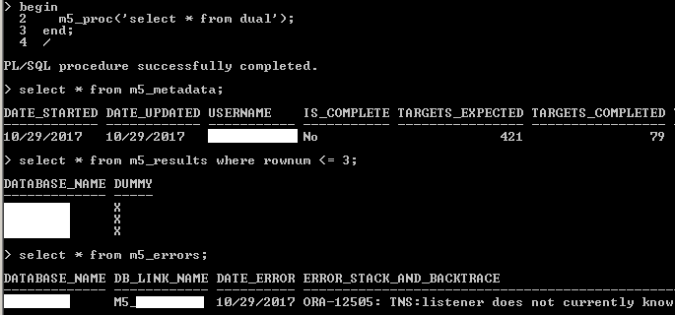
Simple Example - Procedure
Notes:
This screenshot is a complete example of a simple query that can be used to show what databases are responding.
1. First the simple SELECT statement is run through the asynchronous procedure M5_PROC.
2. Next the M5_METADATA table is queried. Since jobs are still running in the background, IS_COMPLETE is still set to No, and the TARGETS_COMPLETED does not equal the TARGETS_EXPECTED yet. You'll probably want to query this view a few times to watch the progress of the background jobs. (Not shown on the screenshot are some other columns like TARGETS_WITH_ERRORS, NUM_ROWS, CODE, and TARGETS.)
3. The current results can be queried in M5_RESULTS. It returns the same columns as the input query, as well as a column for the DATABASE_NAME.
4. M5_ERRORS shows any errors generated while trying to run the query. With a large number of databases it's common for some of them to be unavailable due to maintenance or unexpected errors. A few databases with errors don't stop the other databases from returning results.
(The screenshot does not show all the columns and values because it's hard to fit them on a screen. The example uses SQL*Plus for its simple text formatting, but in practice you will probably want to use an IDE like PL/SQL Developer, Toad, Oracle SQL Developer, etc. The exact same code will run on any IDE.)
If you want to reproduce this example yourself, here's the full code and SQL*Plus commands to format results:
set sqlprompt "> "
column db_link_name format a12
column database_name format a13
column error_stack_and_backtrace format a100
column username format a11
column date_started format a12
column date_updated format a12
column is_complete format a11
column dummy format a5
set serveroutput off
begin
m5_proc('select * from dual');
end;
/
select * from m5_metadata;
select * from m5_results where rownum <= 3;
select * from m5_errors;

Slide 10
Parameters
P_CODE - what to run
P_TARGETS - where to run it
P_TABLE_NAME - where to save it
P_TABLE_EXISTS_ACTION - if it already exists
P_ASYCHRONOUS - return or wait for all rows
P_RUN_AS_SYS - run with SYSDBA privilege
Notes:
1. P_CODE (required) - Any SQL statement, PL/SQL block, or Linux/Unix shell script. The results can be either the query results, a SQL*Plus feedback message for DDL and DML, DBMS_OUTPUT for PL/SQL statements, or standard output and standard error for shell scripts. (Shell scripts require an active database so Method5 cannot yet be used for activities that restart the database, like patching and upgrading.)
2. P_TARGETS (optional, defaults to all databases) - Can be either a comma-separated list (of database names, hosts, lifecycles, lines of business, or cluster names) or a query that returns target names. The names can also include wild-cards. You can configure Target Groups for commonly-used queries.
3. P_TABLE_NAME (optional, defaults to auto-generated name) - The base name for the results, _META, and _ERR tables.
4. P_TABLE_EXISTS_ACTION (optional, defaults to ERROR) - One of ERROR, APPEND, DELETE, or DROP.
5. P_ASYNCHRONOUS (optional, defaults to TRUE) - Return right away or wait for all results.
6. P_RUN_AS_SYS (optional, defaults to FALSE) - Run the command as the SYS user. Commands should only run as SYS when necessary, which is probably less than 1% of the time. This feature has extra protections that prevent other users from calling it. Only the Method5 user from the master database can use this feature. See the security section of the user guide for more details. If you're still worried about it, this feature can be disabled for everyone or for specific users.

Slide 11
Other Features
Tables - data, _META, _ERR
Views - M5_RESULTS, M5_METADATA, M5_ERRORS
M5_ links - M5_* created in your schema
Global Data Dictionary - Common tables refreshed nightly (M5_DBA_USERS, M5_V$PARAMETER, etc.)
Admin Email - Summary of daily issues
Version Star - Use "**" for version differences
Examples - Many pre-built, complex examples
Notes:
1. Tables - Every execution automatically generates three tables. The tables are given default names if none are specified. The tables contain the data, the metadata, and the errors.
2. Views - Since you may not know or remember the table names used, three views are created in your schema. These views always reference the last run. They are M5_RESULTS, M5_METADATA, and M5_ERRORS.
3. M5_ links - Database links are automatically copied and synchronized to your schema. This can be useful for many ad hoc tasks. Simply use @M5_$DBNAME in queries or through DBMS_UTILTY.EXECUTE_DDL_STATEMENT.
4. Global Data Dictionary - Every night Method5 gathers some common data into tables such as M5_DBA_TABLES, M5_V$PARAMETER, M5_USER$, M5_DBA_ROLE_PRIVS, M5_DBA_SYS_PRIVS, and M5_DBA_TAB_PRIVS. Having this data instantly available makes some tasks much simpler, such as finding out where a user exists, or where an object is granted.
5. Admin Email - An email is sent to the administrator every day listing issues encountered by Method5. These problems are often a blessing in disguise. For example, if a job never finished and had to be manually killed that implies one of your databases is unavailable. Method5 will often catch a problem that OEM missed.
6. Version Star - Querying different versions of Oracle can be difficult because the data dictionary has different columns. For example, most data dictionary views in 12c have the new CON_ID column. A "select * from v$..." will return different result sets between 11g and 12c. To get around this issue, if you replace "*" with "**", Method5 will convert the "**" into an explicit list of columns based on the lowest Oracle version. This avoids "not enough values" or "too many values" errors, and ensures that all databases return data regardless of the version. The results will miss some of the newer columns, such as CON_ID.
7. Examples - The /examples folder containers some simple examples as well as some complex, pre-built solutions for some common but complex problems. For example, space forecasting, multi-database schema comparisons, parameter comparisons, etc.

Slide 12
More Simple Examples
1. select * from table(m5('select ** from dba_data_files'));
2. select * from table(m5('#!/bin/ksh df -h|grep /tmp;'));
3. select * from m5_dba_users where username = 'SOME_USER';
4. select * from m5_v$parameter where name = 'resumable_timeout';
5. begin
m5_proc('alter system set resumable_timeout=86400', 'dev');
end;
/
select * from m5_results;
select * from m5_metadata;
select * from m5_errors;
Notes:
Each of these examples can quickly find or resolve a problem on a huge number of databases.
1. This query can help identify data files created in the wrong directory. For example, we use ASM and have tens of thousands of data files. Occasionally when someone forgets to use the plus sign the data file gets created on a local filesystem instead of ASM. This query makes it easy to find those mistakes.
2. This query runs a simple Linux/Unix shell command to find the amount of space used by /tmp. Some /tmp filesystems are stored in memory so if someone stores a huge file in /tmp it can impact performance.
3. Users and consultants often forget that infrastructure DBAs don't know where their schemas are located. Instead of asking them, "what databases are you talking about", we can very easily look up the information ourselves in the global data dictionary. This saves us time and makes us look better.
4. Comparing parameters across a huge number of environments is trivial with the global data dictionary.
5. Fixing bad parameters is also trivial.

Slide 13
Advantages
Performance - fast, parallel, asynchronous
Interface - plain SQL and PL/SQL
Relational - save, share, and join
Administration - for most users - none
Security - hardened, configurable
Exceptions and Metadata - handled, saved
Notes:
Most of the features of Method5 happen in the background and aren't obvious at first.
1. Performance - Asynchronous processing and parallelism make Method5 more responsive and orders of magnitude faster than other tools.
2. Simple interface - The PL/SQL API makes it easy to create and automate tasks. No need to learn a new GUI or IDE, Method5 seamlessly integrates with your existing tools.
3. Relational storage - Everything about the database is stored in the database, making it easier to analyze, save, and share results.
4. Easy administration - Method5 is agentless. Free and open source software only needs to be installed on one central management database. Users do not need to install custom software, manage connections, or modify configuration files. One administrator can configure Method5 and that configuration automatically applies to all users.
5. Security - Method5 has been thoroughly hardened to avoid the typical security problems with multi-database tools. For example, there are no public database links or shared passwords. The program privileges are completely configurable. See the file security.md for more details.
6. Exception handling and metadata - Exceptions and metadata are stored in tables and do not stop other targets from processing. Hung jobs are automatically stopped based on a timeout parameter. Handling these rare problems lets you easily scale your queries to hundreds of databases.

Slide 14
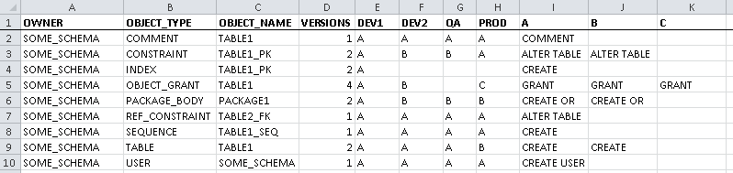
Add-on: Compare Everything Everywhere
Notes:
The next 4 slides are pre-built scripts that show some more complex things that can be accomplished with Method5. When data collection is trivial we can fail fast and spend more time worrying about advanced analysis and visualization. All these complex examples are available on the website and the GitHub repository.
This example is a pre-built script to compare schemas across any number of databases, with all the detailed results in one view. The output is a bit cryptic but once it is understood it allows rapid comparison of environments.
All schema objects are listed in the first three columns, OWNER, OBJECT_TYPE, and OBJECT_NAME. Each database has a separate column, and the column values are a letter like "A", "B", and "C". Those letters map to the different DDL on the right-hand side of the spreadsheet. Environments can be compared simply by looking at the letters. And the full DDL is included to investigate the reason for the difference.

Slide 15
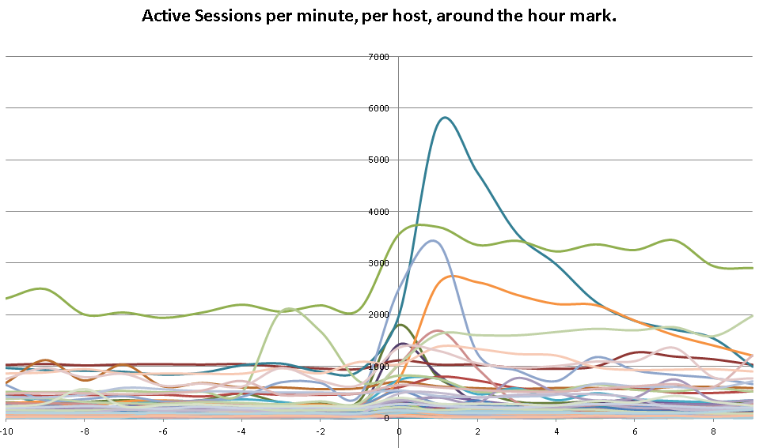
Add-on: Global ASH
Notes:
This example shows how we solved a near-impossible performance tuning task: intermittent performance problems across 400 databases on 80 hosts.
With Method5 this was relatively easy to solve. First we gathered GV$ACTIVE_SESSION_HISTORY from all databases. Aggregating the data per host, and plotting it per time, it was obvious that almost all of our systems had a spike every hour, on the hour. After drilling down on that table we found it was AWR snapshot processing.
Changing AWR_SNAPSHOT_TIME_OFFSET on all databases solved the problem.

Slide 16
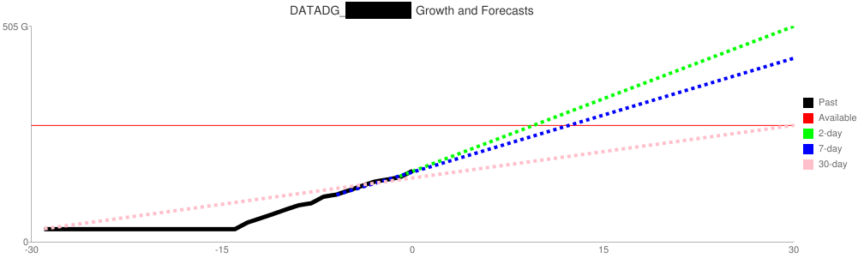
Add-on: ASM Forecast
Notes:
Simplistic alerts like "warn me when 80% of the disk is used" can waste a lot of space. Some systems may sit at 99% for a year and see no change. Other systems might have gone from 0% to 50% in one day, and need to be fixed ASAP.
The solution is a forecast based on historical data. Gathering data nightly from V$ASM_DISKGROUP is simple with Method5. With all the data stored in one table, it's possible to create an ordinary least squares regression using the REGR_* functions.
An email is generated using those data and forecasts. The top servers are not the ones with the highest percent of storage. The top servers are the ones forecasted to run out of space first. The forecasts are generated as HTML with links to Google Charts, which returns static PNG images that can be rendered in an email client.

Slide 17
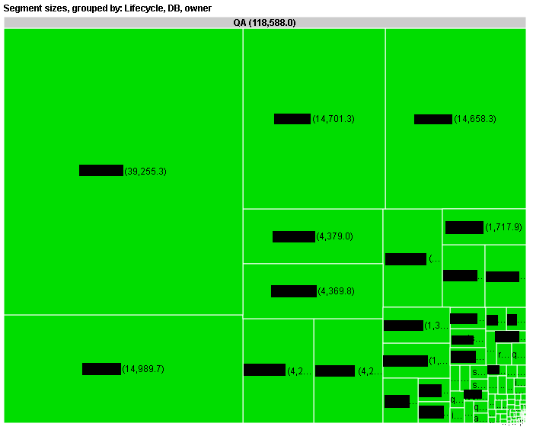
Add-on: Space Treemap
Notes:
This visualization helps answer the question "where is all the space going?" It's a difficult question, especially if there are hundreds of databases and thousands of schemas.
Once again, gathering the data is trivial, just run this command in Method5: select owner, sum(bytes) bytes from dba_segments group by owner;
Then SQL and PL/SQL generate an HTML page that calls the Google Visualization TreeMap. The TreeMap is multiple levels deep, and you can click on each box to zoom in. The grouping order is configurable, so you can create different TreeMaps with different groupings. For example, you may want to see the largest database first, then grouped by the largest owner. Or you cam see the largest owner, then grouped by database.

Slide 18
Add-on: Account Management
begin
m5_synch_user(
p_username => '&USERNAME',
p_targets => '&TARGETS',
p_table_name => 'SYNCH_USER',
p_create_user_if_not_exists => false,
p_create_user_clause => '',
p_synch_password_from_this_db => '&DB_NAME',
p_unlock_if_locked => false,
p_profile => '&PROFILE',
p_role_privs => '',
p_sys_privs => ''
);
end;
/
Notes:
This add-on doesn't look exciting, and it takes a while to understand how to use it, but it can be a real life-saver. This procedure lets you create or synchronize accounts on a huger number of databases in one call.
Note that you do NOT need an add-on for all user account maintenance. Most account changes are done through simple SQL statements and you can still call them directly in M5 or M5_PROC. This add-on has a lot of extra logic to do things like synchronize a password hash, check if the role exists before granting it, etc.

Slide 19
History
2006 - idea, early prototypes
2013 - started development
2014 - used in production databases
2016 - released as open source
First production installation at Ventech Solutions: 400 databases 15 million runs 1 petabyte of data dozens of users
Notes:
You've probably seen this problem solved poorly many times before, you should be skeptical. There are a lot of horrible ways to run commands on multiple targets. Creating a good solution took a lot of time and a lot of missteps.
1. Lots of DBAs and developers have thought about these problems. For me it started around 2006, working with different Method4 implementation and never quite worked.
2. Development on a serious solution began in 2013 at General Dynamics.
3. The program was used on production databases in 2014, at Ventech Solutions to support a contract with the Centers for Medicaid and Medicare Services.
4. After 2 years of begging I finally got permission to open source it in 2016. (Hopefully, due to policies such as the Federal Source Code Policy, this process won't be quite as painful for others in the future.)
5. At Ventech Solutions it's been used to manage over 400 databases. The program has run more than 15 million commands, and helps manage 1 petabyte of data. Dozens of people, from several different teams, have used the program.

Slide 20
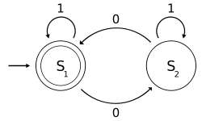
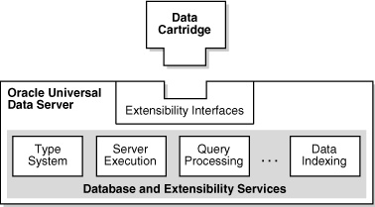
Architecture
Dynamic, templated SQL and PL/SQL
Database Links
PL/SQL Lexer
DBMS_SCHEDULER, DBMS_PIPES
Table-driven configuration
Oracle Data Cartridge
1800 automated tests
Notes:
1. Like any good database solution, the heavy-lifting is done with SQL statements glued together with PL/SQL. The dynamic code is nested several levels deep. To avoid the typical concatenation-hell, the alternative quoting mechanism and REPLACE are used. This simple trick makes dynamic code drastically more readable.
2. Database links tie everything together. Database links have gotten a bad reputation. Yes, many people make horrible mistakes with them, but when used right it makes inter-database communication incredibly simple.
3. 99% of all Oracle SQL code parsing or code transformation programs are fundamentally broken. Things like statement classification and terminator removal are often handled with simple regular expressions. SQL and PL/SQL are insanely complicated languages, with over 2,000 keywords and 30 years of syntax history. A proper lexer is a requirement to build a robust system that can handle any code you throw at it.
4. Scheduler and pipes work together to enable parallelism and asynchronous processing. DBMS_SCHEDULER also enable the execution of shell scripts.
5. Everything is configured in tables. You don't have to worry about XML configuration files or agent parameter files.
6. Oracle Data Cartridge is the magic (or at least cryptic) piece that allows Method5 to extend Oracle SQL. It provides the ability to return "anything", dynamically, in a SQL context. Running dynamic SQL in SQL is much harder than it sounds.
7. The 1800 automated unit tests ensure that each release maintains the same quality. And it gives us the confidence to make changes just to make things look better, reducing our technical debt.

Slide 21
Install and Administer
Requirements
One DBA needed for setup and administration
Download open source code, follow install_method5.md and administer_method5.md
Everything lives inside the database
How much time will it take?
Create GitHub issue or send email if you want help Any DBA can try it out in a few hours
Notes:
1. You must have a central management database that can communicate with all other database. (If you don't have that, take a look at Oracle Connection Manager. It's a free program that you can use as a proxy for database connections.) You must have SYSDBA to install, and DBA privileges to use. Any currently-supported platform, version, or edition will work. (And probably some unsupported ones also.) For testing you only need a single database - the default installation will create some fake links that simulate a multi-database environment.
2. Only one person needs to install and administer it. The configuration is automatically applied to other users.
3. Download the free, open source code from GitHub and follow the instructions. You don't need to purchase any additional hardware or software.
4. The code is 100% inside the database - there are no agents, plugins, websites, configuration files, etc.
5. Getting started will only take a few hours. The time to setup all your connections will vary depending on how standardized your environment is. 1000 perfectly-standardized databases will be easier than 10 databases all with different platforms, versions, and configurations. One of the nice side-effects of Method5 is that it really drives home how useful standardization can be. You may want to work on one environment at a time; you don't need to get every database working in order to use this.
6. If you encounter any problems you can create a GitHub issue on the repository or you can email Jon Heller at either jon.heller@ventechsolutions.com or jon@jonheller.org.
Most DBAs have everything they need to get started in a few hours. You don't need to buy anything, sign up for anything, or install any operating system binaries. The installation and administration tasks aren't that different from what you do on a day-to-day basis.

Slide 22
Security: Why Method5 is Safe
1. Public database links, password sharing, direct logons
2. Auditing - M5_AUDIT and database audit trail
3. Multi-Step Authentication - Oracle and OS username
4. Intrusion Detection - Invalid access or config changes email admin
5. Shell Script and SYS - Commands from master are encrypted, remote DBA cannot break into it
6. Open Source - Not just security through obscurity
Notes:
Remote execution is a powerful tool that must be properly secured. Method5 has been carefully hardened to avoid security issues.
1. No stupid mistakes. There are no public database links. That should go without saying but it's unfortunately all too common for homemade scripts to use that insecure feature. And the links are one-way, from master to remote; there's no link pointing from remote back to the master database. Method5 only uses password hashes and never displays or stores any passwords. Nobody will ever know the Method5 password. Even if someone happens to break into a system, steal the password hash, and decrypt it on a supercomputer, it still won't work. Method5 accounts are protected by a schema trigger that does not allow users to directly connect to it.
2. Auditing. All commands are audited, both in M5_AUDIT and in the database audit trail. You can always tell who ran what, when.
3. Multi-step authentication. Users can only access Method5 from an expected operating system username. This provides at least multi-step authentication, and it may provide multi-factor authentication if your operating system authentication requires a token. (This feature can be disabled.)
4. Intrusion detection. An email is sent to the administrator whenever someone tries to access M5 or M5_PROC with the correct authorization, or whenever someone changes one of the critical configuration tables. This will hopefully alert you if someone is trying to break into Method5.
5. Shell script and SYS. The shell script and SYS commands are extra powerful and have extra protection. Even if somebody breaks into a DBA account on a remote database they will not be able to use those features. The code for those features is stored in the SYS schema, and requires a properly encrypted command sent from the master database.
6. Open source. Most commercial programs rely on security through obscurity, as if hackers can't easily unwrap or decompile code and find obvious mistakes. With open source code everyone can easily review code, find bugs, and report them.

Slide 23
Security: Minimum Privileges
 | Method5 | User
Master | High | Low
Remote | Medium - High | None
Notes:
Remote execution adds some complexity to privileges. But that doesn't mean they can't be controlled. Below are some highlights but you may also want to see security.md for details.
This table visualizes the 4 different types of privileges you need to consider. You have to think about the METHOD5 schema as well as user schemas, on the master database as well as the remote databases.
1. METHOD5 schema on the master database, requires the highest privileges. The program needs to run and schedule jobs for other users, which means it effectively needs DBA access. There's a little room for configuration here but not much.
2. METHOD5 schema on remote databases, also requires some potentially high privileges. You can theoretically shrink those privileges, but that significantly decreases the usefulness of Method5 and disables the user sandbox feature. This could be useful if, for example, you would only want to allow read-only access.
3. User schema on master database, you don't have to worry about. The privilege requirements are very small - basically just a user that can connect and create some objects on their own schema.
4. User schema on remote database, is the most important privilege. It is completely configurable. You can create a user with almost no privileges (that can only use public objects), up to allowing DBA. For non-DBA users, a temporary sandbox schema is created for each execution. That schema is only granted the exact privileges specified. Since it's an isolated Oracle user there's no way for them to break out of their jail. (Unless your databases already have security holes, like important tables granted to public.)

Slide 24
Security: User Configuration
1. M5_USER - username (oracle and OS), email, is admin, default targets
2. M5_ROLE - name, targets, sys, shell, links, sandbox
3. M5_ROLE_PRIV - role, privilege
4. M5_USER_ROLE - username, role
Notes:
Below are the full comments for the tables and columns:
**METHOD5.M5_USER** is mostly used for authentication and authorization. * ORACLE_USERNAME: Individual Oracle account used to access Method5. Do not use a shared account. * OS_USERNAME: Individual operating system account used to access Method5. Depending on your system and network configuration enforcing this username may also ensure two factor authentication. Do not use a shared account. * EMAIL_ADDRESS: Only necessary for administrators so they can be notified when configuration tables are changed. * IS_M5_ADMIN: Can this user change Method5 configuration tables. This user will also receive emails about configuration problems and changes. Either Yes or No. * DEFAULT_TARGETS: Use this target list if none is specified. Leave NULL to use the global default set in M5_CONFIG. * CAN_USE_SQL_FOR_TARGETS: Can use a SELECT SQL statement for choosing targets. Target SELECT statements are run as Method5 so only grant this to trusted users. Either Yes or No. * CAN_DROP_TAB_IN_OTHER_SCHEMA: Can set P_TABLE_NAME to be in a different schema. That may sound innocent but it also implies the user can drop or delete data from other schemas on the management database. Only give this to users you trust on the management database. Either Yes or No.
**METHOD5.M5_ROLE** allows complete control over the targets and features available to each user. The column comments explain how to use each setting:
* ROLE_NAME: Name of the role.
* TARGET_STRING: String that describes available targets. Works the same way as the parameter P_TARGETS. Use % to mean everything.
* CAN_RUN_AS_SYS: Can run commands as SYS. Either Yes or No.
* CAN_RUN_SHELL_SCRIPT: Can run shell scripts on the host. Either Yes or No.
* INSTALL_LINKS_IN_SCHEMA: Are private links installed in the user schemas. Either Yes or NO.
* RUN_AS_M5_OR_SANDBOX: Run as the user Method5 (with all privileges) or as a temporary sandbox users with precisely controlled privileges. Either M5 or SANDBOX.
* SANDBOX_DEFAULT_TS: The permanent tablespace for the sandbox user. Only used if RUN_AS_M5_OR_SANDBOX is set to SANDBOX. If NULL or the tablespace is not found the default permanent tablespace is used.
* SANDBOX_TEMPORARY_TS: The temporary tablespace for the sandbox user. Only used if RUN_AS_M5_OR_SANDBOX is set to SANDBOX. If NULL or the tablespace is not found the default temporary tablespace is used.
* SANDBOX_QUOTA: The quota on the permanent tablespace for the sanbox user. Only used if RUN_AS_M5_OR_SANDBOX is set to SANDBOX. This string can be a SIZE_CLAUSE. For example, the values can be 10G, 9999999, 5M, etc. If NULL then UNLIMITED will be used.
* SANDBOX_PROFILE: The profile used for the sandbox user. Only used if RUN_AS_M5_OR_SANDBOX is set to SANDBOX. If NULL or the profile is not found the DEFAULT profile is used.
**METHOD5.M5_ROLE_PRIV** grants privileges to an M5_ROLE.
* ROLE_NAME: Role name from METHOD5.ROLE.ROLE_NAME.
* PRIVILEGE: An Oracle system privilege, object privilege, or role. This string will be placed in the middle of: grant <privilege> to m5_temp_sandbox_XYZ; For example: select_catalog_role, select any table, delete any table.
**METHOD5.M5_USER_ROLE** grants a M5_ROLE to an M5_USER.
* ORACLE_USERNAME: Oracle username from METHOD5.M5_USER.ORACLE_USERNAME.
* ROLE_NAME: Role name from METHOD5.ROLE.ROLE_NAME.

Slide 25
Security: Query Examples
1. m5_proc('#!/bin/ksh'||chr(10)||'crontab -l', '%');
2. m5_proc('#!/bin/ksh . /export/home/oracle/set_localASM.sh cat $ORACLE_HOME/network/admin/sqlnet.ora', '%');
3. m5_proc('select ** from dba_profiles', %');
4. m5_proc('select ** from dba_audit_trail where returncode in (1017,2800)', %');
5. select database_name, value from m5_v$parameter where name = 'sec_case_sensitive_logon';
6. select * from m5_dba_role_privs where granted_role = 'DBA';
Notes:
With Method5 it becomes almost trivial to harmonize common security settings. These simple snippets can save hours of data gathering, enabling you to compare settings that you would never otherwise bother to compare.

Slide 26
Your New Mission: Automate Everything
Remote execution is not just faster
Find, fix, and prevent all problems on all databases
Be proactive (preventive maintenance)
Work on only ONE database
Notes:
1. Method5 isn't simply faster than your existing processes. It's so much faster that it can change your attitude toward solving problems.
2. For every problem, spend a minute thinking if there's a way to find it, fix it, and prevent it on other databases. There's no more excuse to not check every database - it only takes one line of code.
3. Start being more proactive - no more Groundhog Day administration. Even if the problem only takes you 5 minutes to fix each time, consider how much time everyone else spends on it before it even gets reported to you. When you find a problem and write a Method5 snippet for it, save that code. After a while you can generate a preventive maintenance program that you can run periodically to fix things before they become a problem. You'll be amazed how often a single query today can save your organization hours of work tomorrow.
4. If we could wave a magic wand it would be great to put our entire data center into a single box, in a single database. While that's not possible we can sometimes pretend that's the case. With the right remote execution tools we only need to logon to one system, and we can treat all our databases as one logical database.

Slide 27
Download It Now: https://method5.github.io
Everything is open source and free
Problems? Want help installing? Email me or create a GitHub issue: jon@jonheller.org jon.heller@ventechsolutions.com https://github.com/method5/method5
Notes:
This is one of the few things you'll hear about at this conference that you can do right now. If you are an Oracle DBA you don’t need any additional hardware, privileges, agent binaries, or money. The default installation only creates loop-back links that refer to the same database, so you can install it on a sandbox database first if you want.
Please feel free to contact me with any questions or comments. I'm happy to help walk you through the installation if you want help. If something is broken or wrong, use shame-driven-development: create a GitHub issue and embarrass me until I fix it.

